Slide 1
Impact of K and Harmful Examples on K-NN Classifiers
Jackson Westwood
Kyle Scott

Slide 2
Introduction
What is the K-NN algorithm?
The value for K will have great impact upon the classification of a testing example
k=1
Simple; Classifies the example as the closest training example
k=5
Imagine an example with nearest neighbors classified as red, red, blue, blue, red
What will happen?

Slide 3
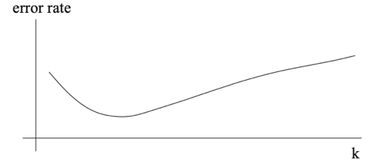
Introduction
What is the problem with setting k=1?
Potential exposure to things like class label noise, leads to a higher error rate
Generally, the plot of error rates will look like this:

Slide 4
Introduction
The K-NN algorithm can be susceptible to noise, so what can be done to limit this?
Remove outlier and borderline examples using Tomek Links
Given an Example pair [X,Y]:
X is the nearest neighbor of Y
Y is the nearest neighbor of X
X and Y so not belong to the same class
Remove the Tomek Links should help to reduce noise, theoretically lowering the error rate found by training with the original dataset

Slide 5
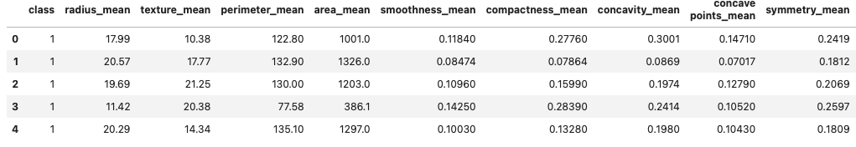
Dataset - “Breast Cancer Wisconsin”
This dataset involves 30 variables to determine whether or not a breast mass is malignant or benign.
Head of the data for the first few columns:

Slide 6
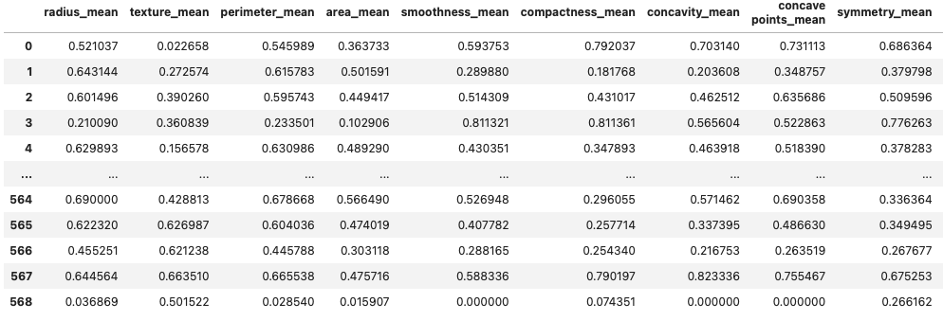
Dataset - “Breast Cancer Wisconsin”
Base data from the previous slide has columns with data magnitudes larger than the rest
Why is this an obvious problem for K-NN? (Skews euclidean distances)
What can be done?

Slide 7
K-NN Algorithm - “Breast Cancer Wisconsin”
Our data is now ready to be split into Training and Testing sets
In this study, we chose the breakdown of 70% vs 30%
Can be done easily and randomly using a split function from sklearn
We will create a model and train it using the training set
Run through the model with the testing set and plot the results

Slide 8
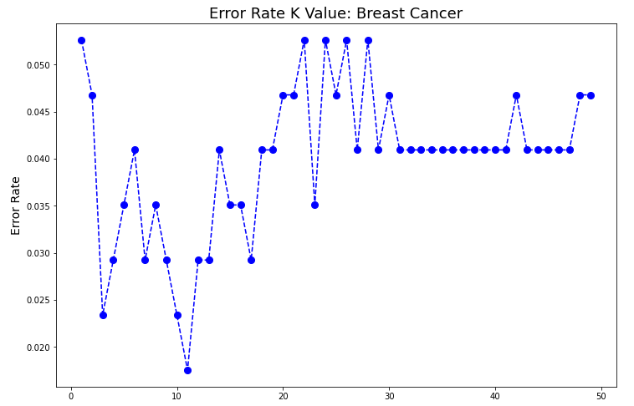

Slide 9
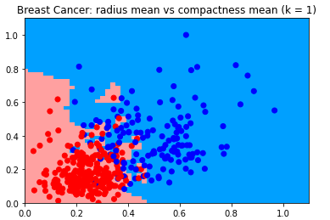
Visualize K-NN - “Breast Cancer Wisconsin”
How can we visualize how the K-NN algorithm works in our data when our dataset has 30 attributes?
For the sake of argument, split the data into only two variables. We have used ‘radius_mean’ and ‘compactness_mean’

Slide 10
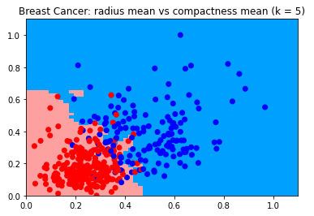
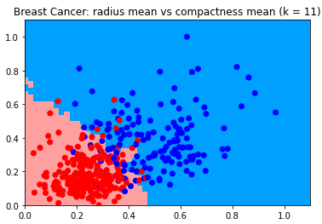

Slide 11
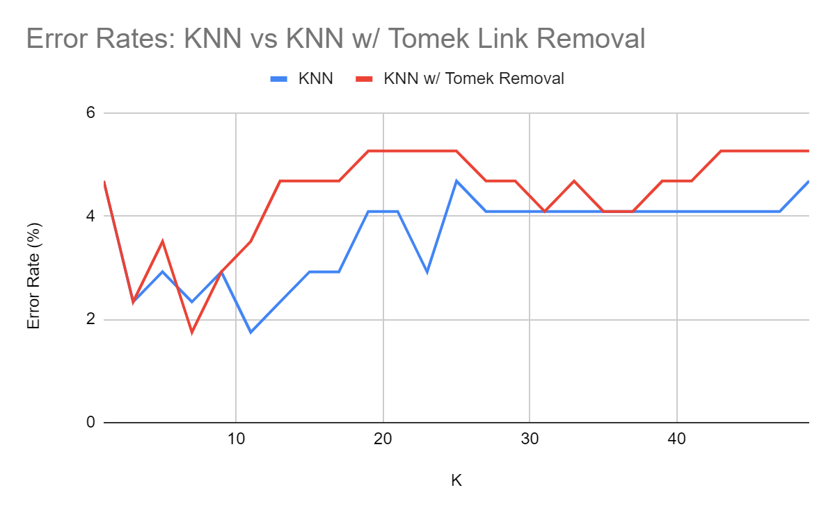
Breast Cancer Classification:
KNN vs. KNN w/ Tomek Removal
Tomek Link removal did not increase classification performance in this dataset
30 attributes - Is this too many?
Notes:
Only best at k=7. Cannot be considered better performance. In fact it is actually much worse for k=11-29.

Slide 12
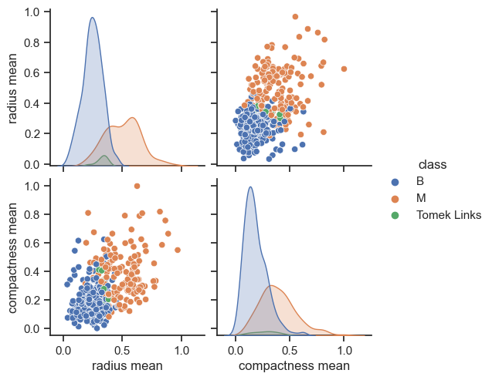
30-D Tomek Removal
(2D visualization of radius mean vs. compactness mean)

Slide 13
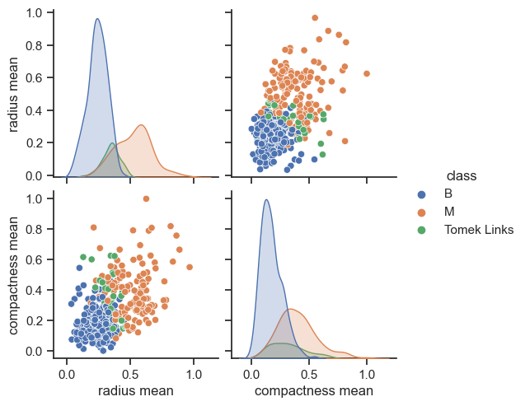
2-D Tomek Removal

Slide 14
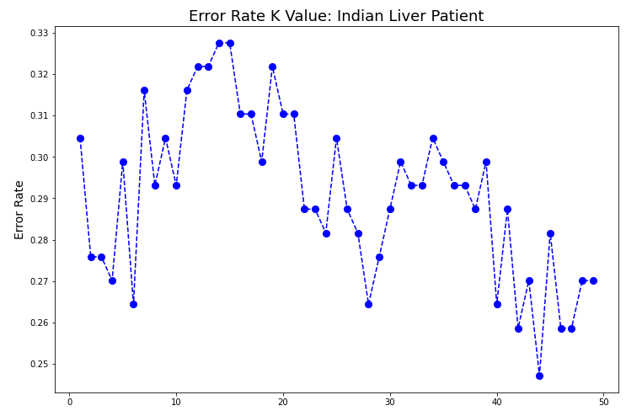
K-NN Error Rates: “Indian Liver Patients”

Slide 15
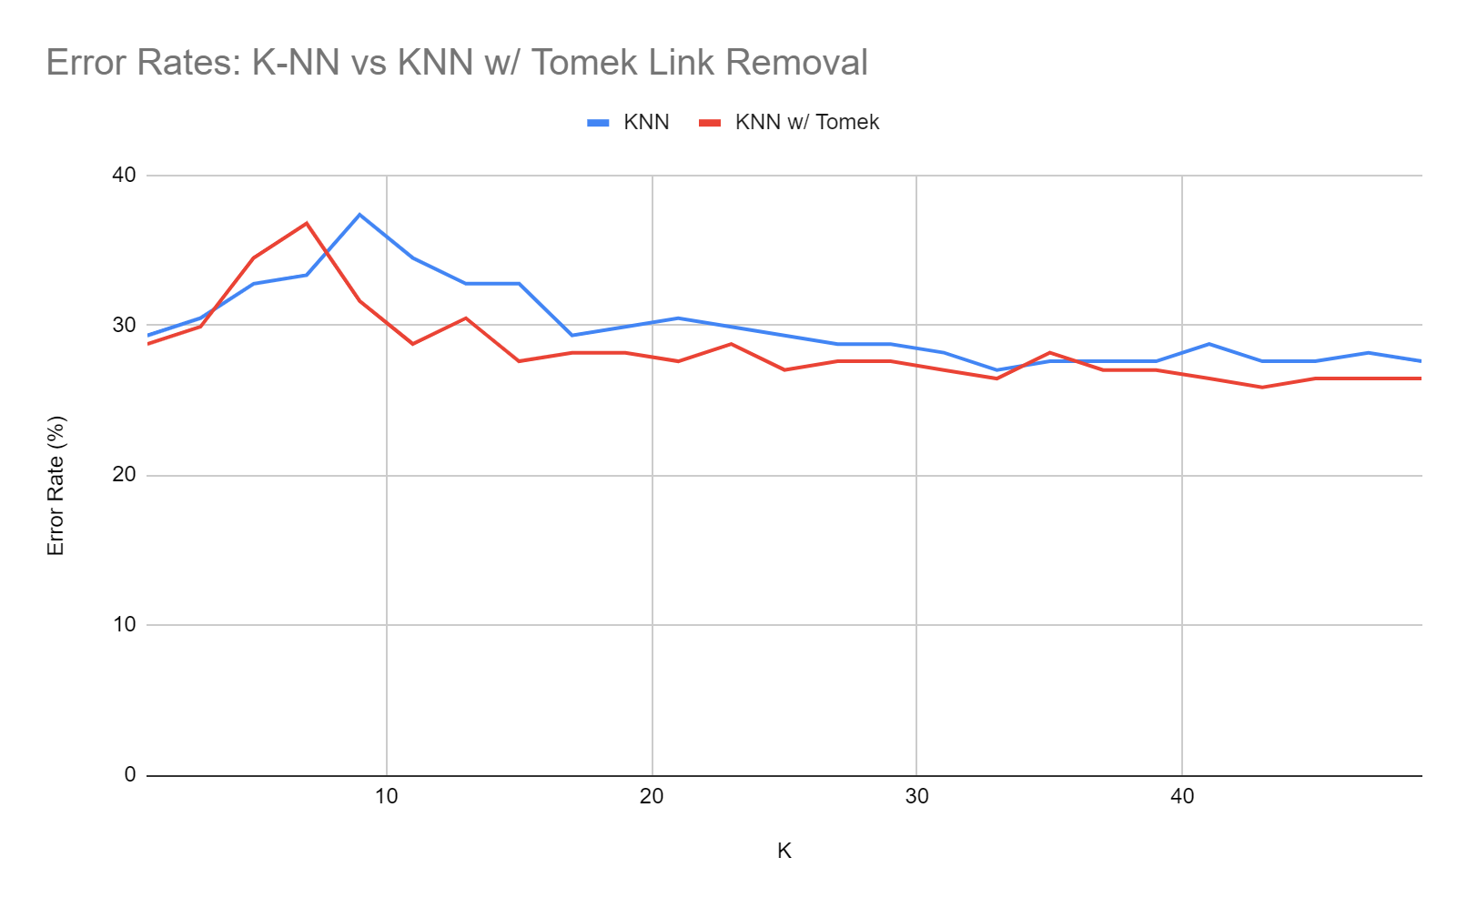
Tomek Link Analysis - ILPD
Notes:
Overall better performance, was beat at k= [5,7,35]. 10 attributes for this set, 78 tomek links removed

Slide 16
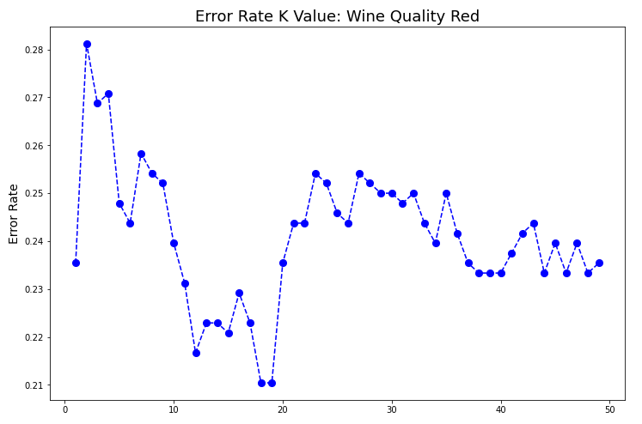
KNN-Error Rates: “Wine Quality-Red

Slide 17
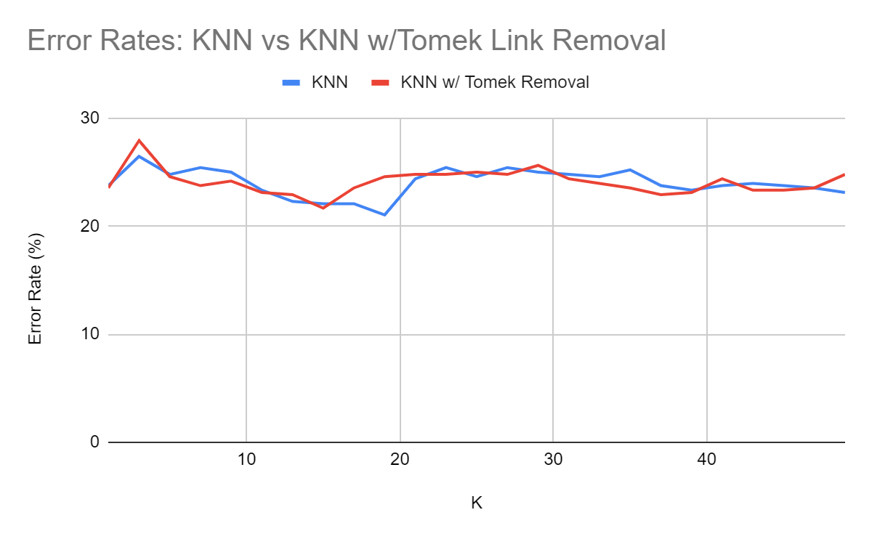
Tomek Link Analysis - Wine Quality
Notes:
12 attributes, 170 tomek link removals
Only really beat for k = 5,7,9,11. Likely caused by overlapping distributions and binarization of classifiers

Slide 18
Discussion/Takeaways
Looking at our 3 datasets, we found the “Curse of Dimensionality” to follow closely with our results
We found as more variables are added to a dataset, K-NN struggles to perform strongly as a model
In the Indian Liver Patient Dataset, there were a total of 583 different examples, 416 of which were liver patients and 167 were not liver patients
This also caused us some problems due to the difference in classified examples (drowning out effect)
In the future, it may have been wise to manipulate the dataset to cut the number of liver patients in half
The pattern within our error rate results was not always consistent with theoretical expectation, and regardless was quite variable
This causes difficulty in choosing a proper K value to classify new data in a practical case

